Slide 1
ASSC
Automatic Sleep Stage Classification
解正平 劉維凱 張景程

Slide 2
Outline
Introduction
Sleep Cycles
Experiment
Data acquisition
Pre-preprocess
Feature extraction
Classification
Completed work
Application
Reference
Q & A

Slide 3
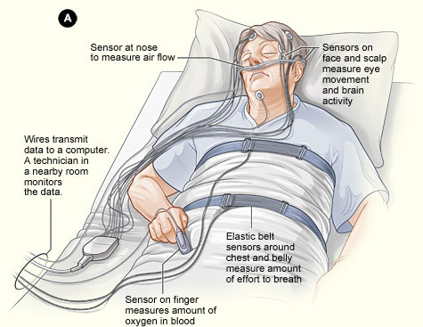
Introduction
Sleep disorder - sleep apnea, insomnia, narcolepsy
Drowsiness when driving
Wearable EEG recording device
PSG(Polysomnographic) -> EEG, EMG, EOG
Accuracy, sensitivity and specificity
Application for alarm clock

Slide 4
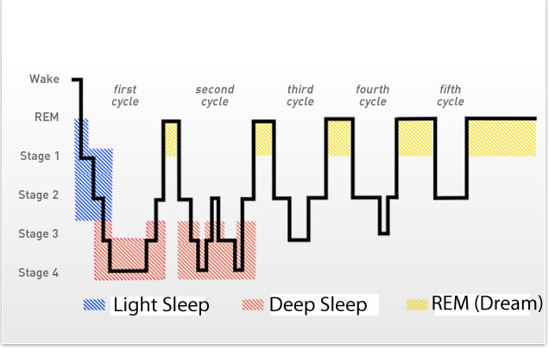
Sleep Cycles – 90 mins
Wake
NREM
Light
Stage 1, 2
Deep
Stage 3, 4
REM

Slide 5
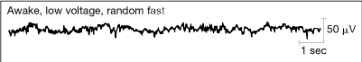
Wake
Beta Wave (14-30Hz)
Low voltage
Random fast

Slide 6
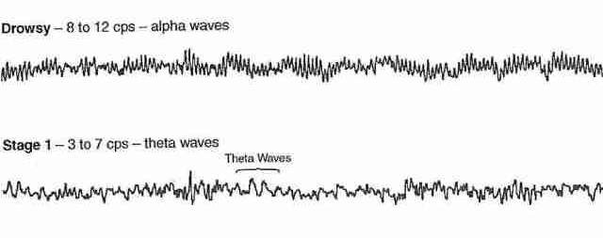
Stage 1
Alpha Wave (8-12Hz)
Theta Wave (3-7 Hz)
hypnagogic state
hypnic jerks

Slide 7
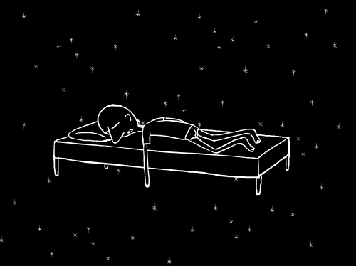

Slide 8
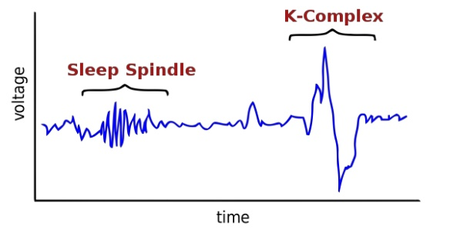
Stage 2 – 45%
Theta Wave (3-7 Hz)
spindles waves - bursts of intense brain waves (11 –15 Hz)
k-complexes - High amplitude sharp waves.
No eye movement, slow HR, decrease in body temperature

Slide 9
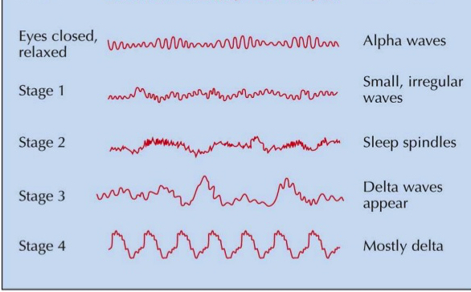
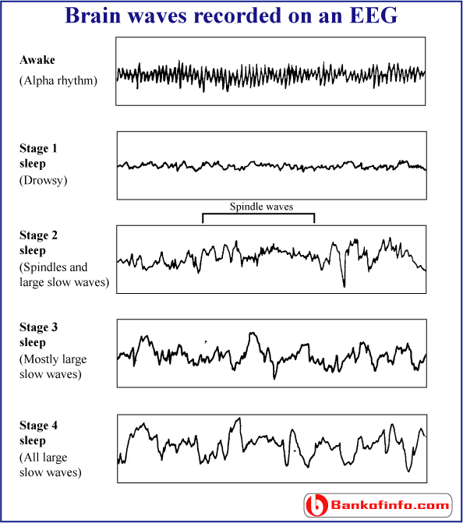
Stage 3
delta Wave (2-4 Hz)
more than 20% and less than 50% of epoch time occupied by slow waves.
Theta Wave (3-7 Hz)
Large slow waves

Slide 10
Stage 4
delta Wave (0.5-2 Hz)
Sleep walking, sleep talking and night terrors

Slide 11


Slide 12
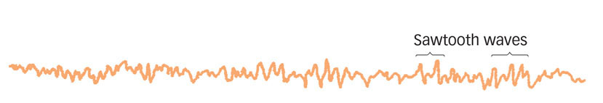
REM
Rapid Eye Movement -> EOG
Get longer and longer
Increase of HR, rhythm irregular
Similar to waking -> dream
Low voltage, high frequency
Sawtooth wave

Slide 13
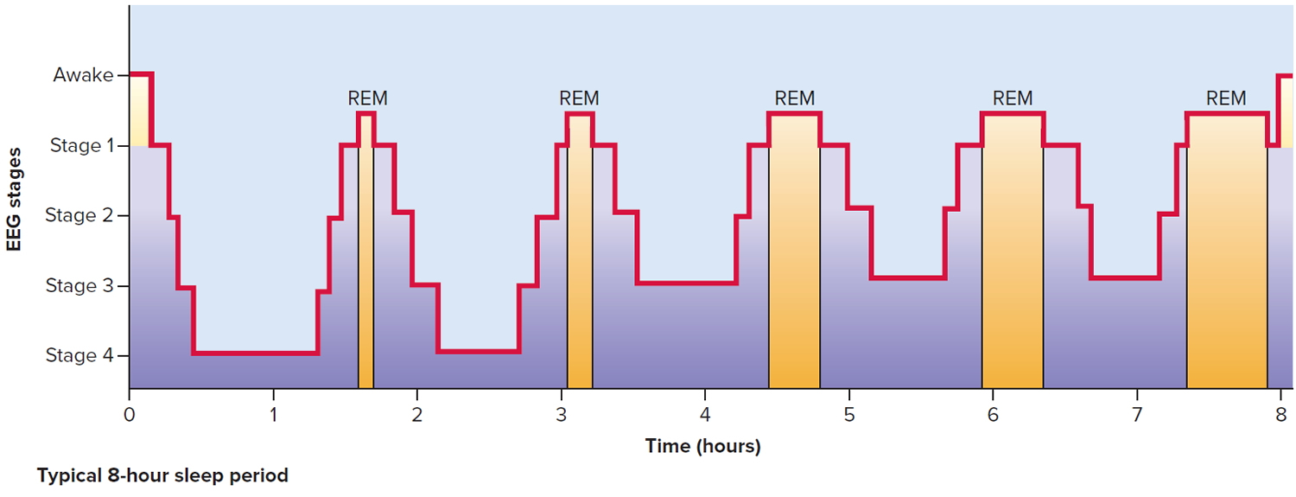
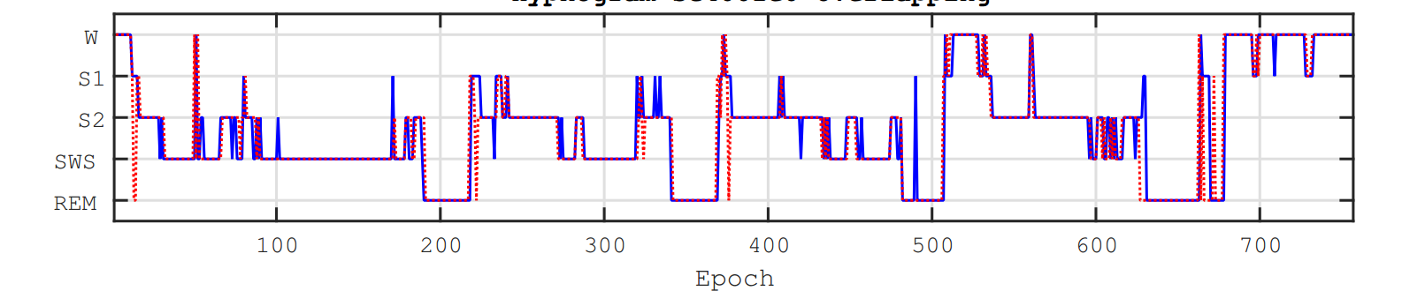

Slide 14
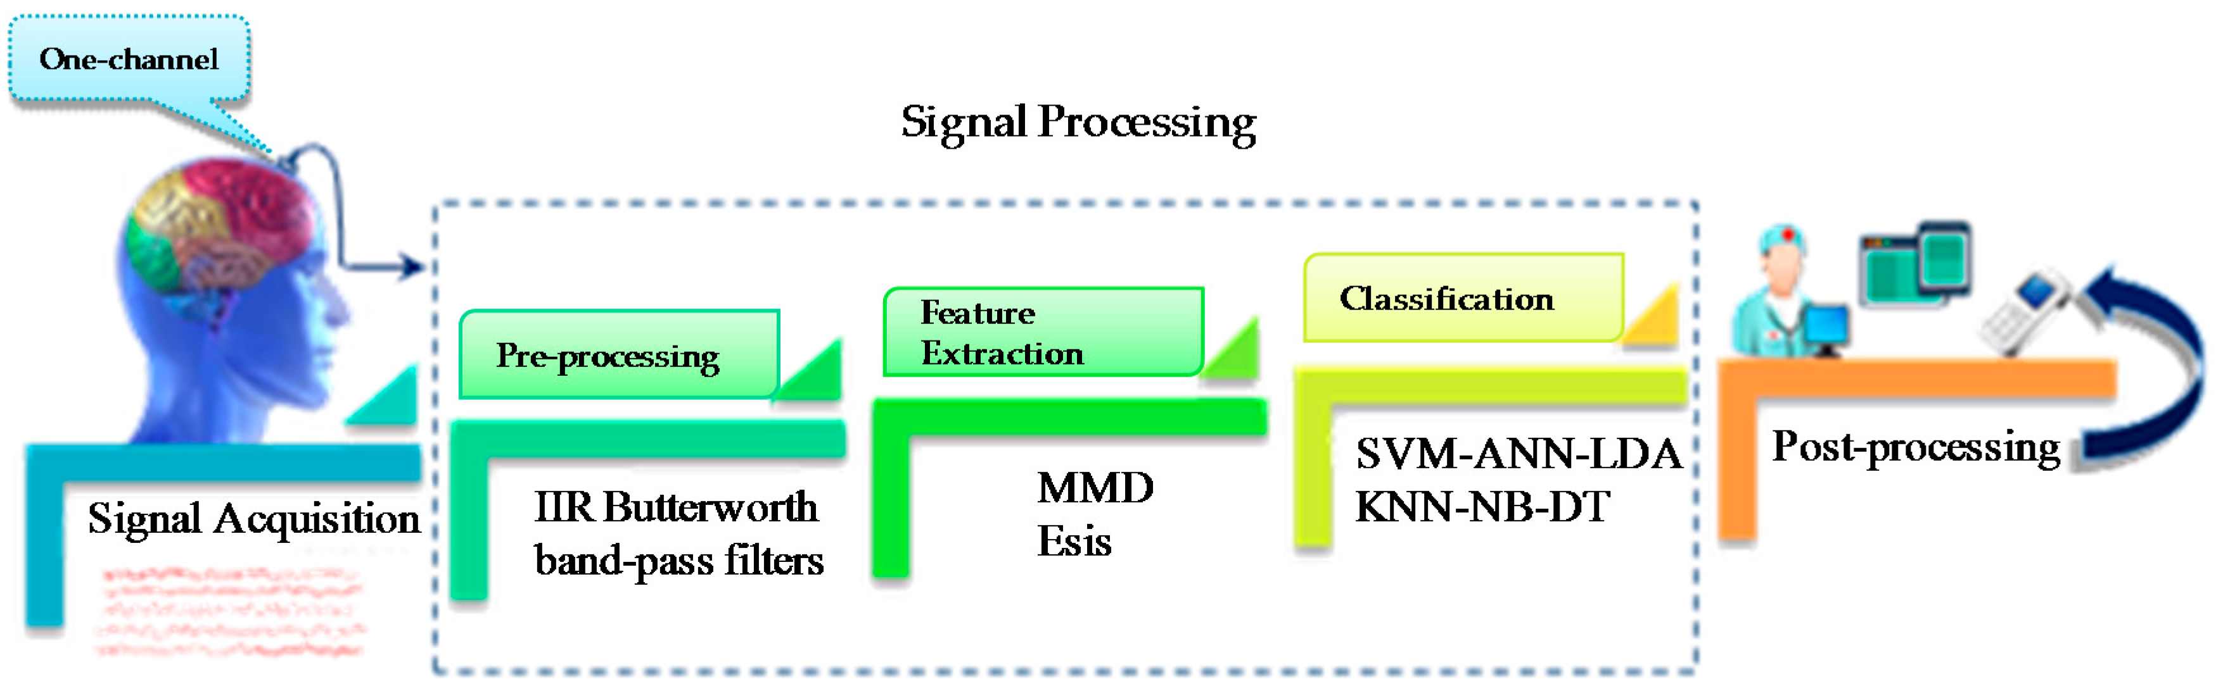
Experiment

Slide 15
Experiment
Data acquisition
EDF-database
PSG test
R&K manual => W, R, 1, 2, 3, 4, M, ?
62 subjects
Preprocess
EDF -> CSV
Remove extreme value
Butterworth band-pass filter
Epoch -> 3000 samples

Slide 16
Experiment
Feature extraction
Time (standard statistics)
Frequency (spectral entropy)
Time-frequency (wavelet transform)
Complexity methods (multiscale entropy)
Feature selection
/dimension reduction
PCA
SFSM
LDA

Slide 17
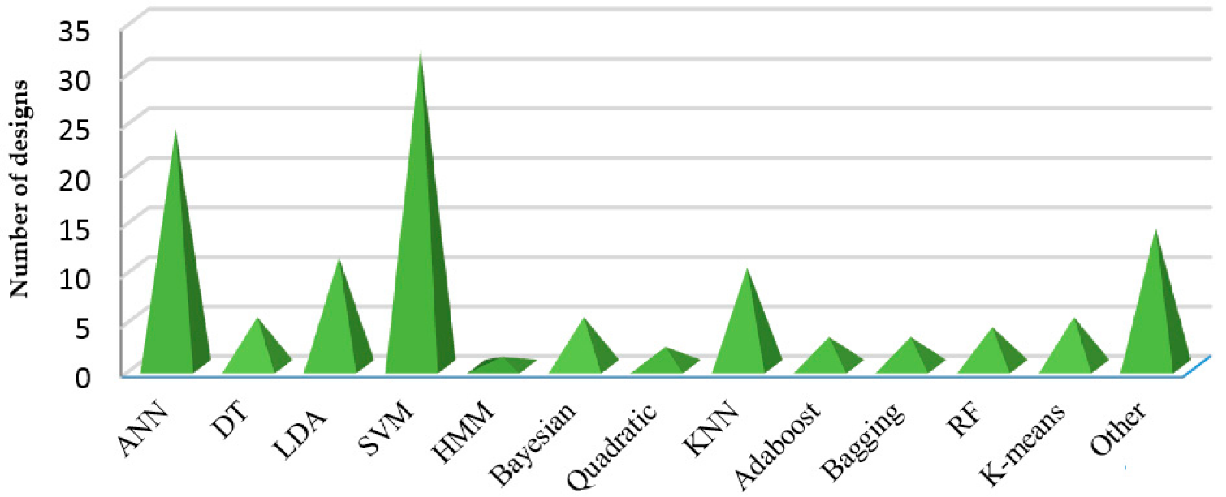
Experiment
Classification
SVM
DT
KNN
CNN
RNN

Slide 18

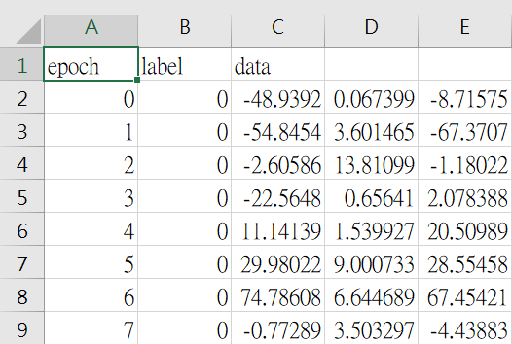
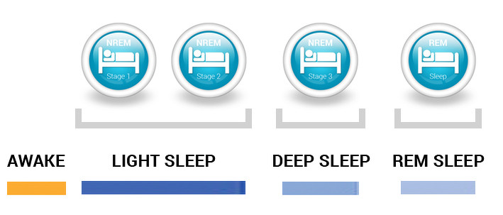

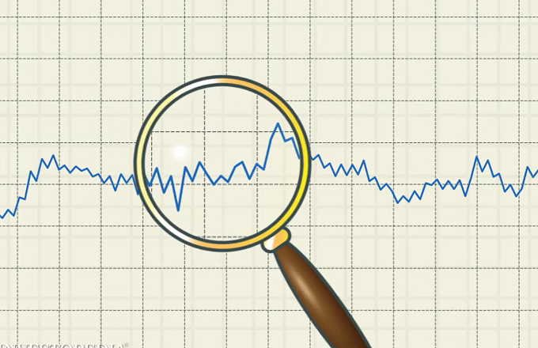
Completed work

Slide 19




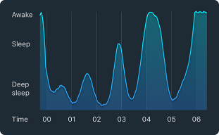
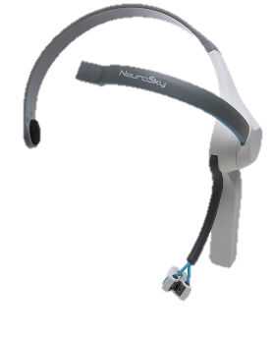


Application
Real-Time

Slide 20


Slide 21
Reference
[1] Alickovic, Emina, and Abdulhamit Subasi. "Ensemble SVM method for automatic sleep stage classification." IEEE Trans. on Instrumentation and Measurement (2018).
[2] Nakamura, Takashi, et al. "Complexity science for sleep stage classification from EEG." Neural Networks (IJCNN), 2017 International Joint Conference on. IEEE, 2017.
[3] Ebrahimi, Farideh, et al. "Automatic sleep stage classification based on EEG signals by using neural networks and wavelet packet coefficients." Engineering in Medicine and Biology Society, 2008. EMBS 2008. 30th Annual International Conference of the IEEE. IEEE, 2008.
[4] Aboalayon, Khald Ali I., et al. "Sleep stage classification using EEG signal analysis: a comprehensive survey and new investigation." Entropy 18.9 (2016): 272.
[5] Yulita, Intan Nurma, Mohamad Ivan Fanany, and Aniati Murni Arymurthy. "Combining Deep Belief Networks and Bidirectional Long Short-Term Memory." Proceeding of the Electrical Engineering Computer Science and Informatics 4 (2017): 88-93.
[6] Chambon, Stanislas, et al. "A deep learning architecture for temporal sleep stage classification using multivariate and multimodal time series." arXiv preprint arXiv:1707.03321 (2017).
[7] Zhang, Junming, and Yan Wu. "A New Method for Automatic Sleep Stage Classification." IEEE transactions on biomedical circuits and systems 11.5 (2017): 1097-1110.

Slide 22
Q & A

